Slide 1
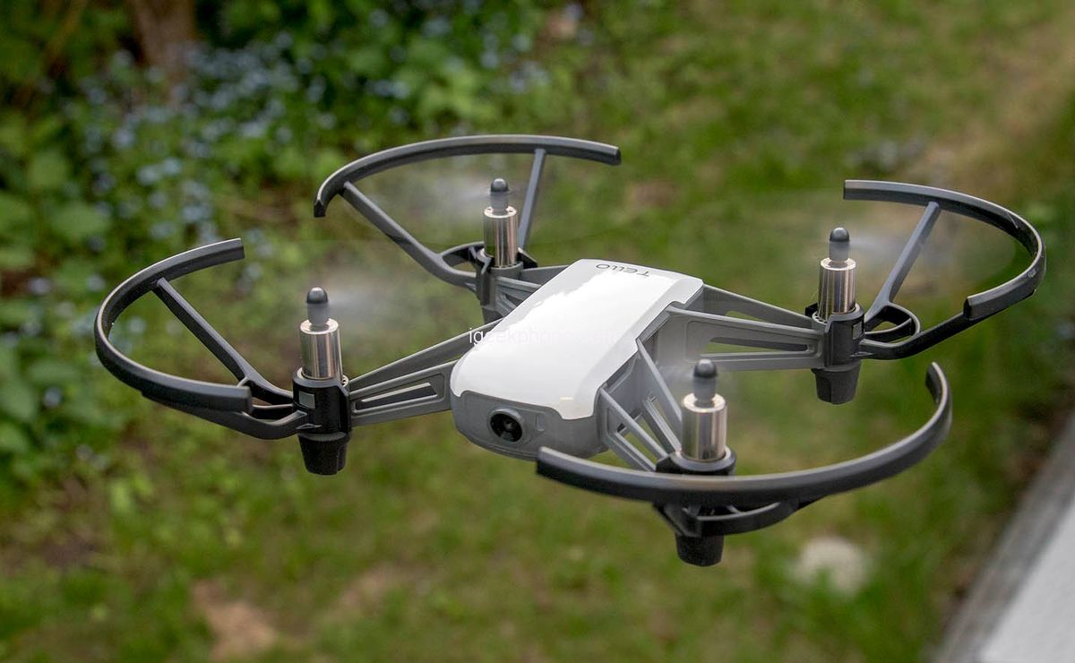
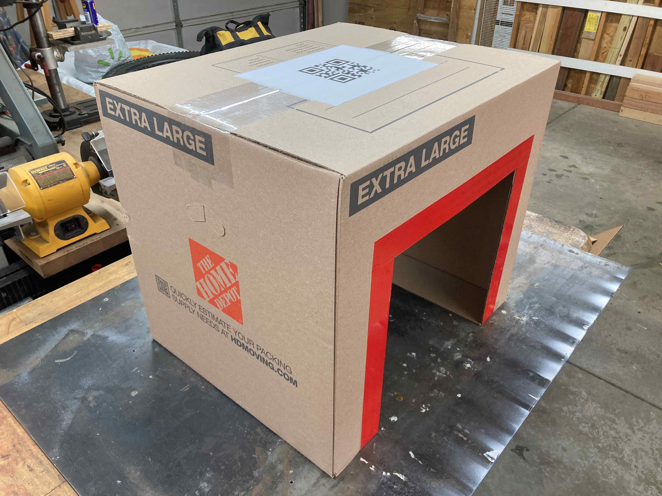
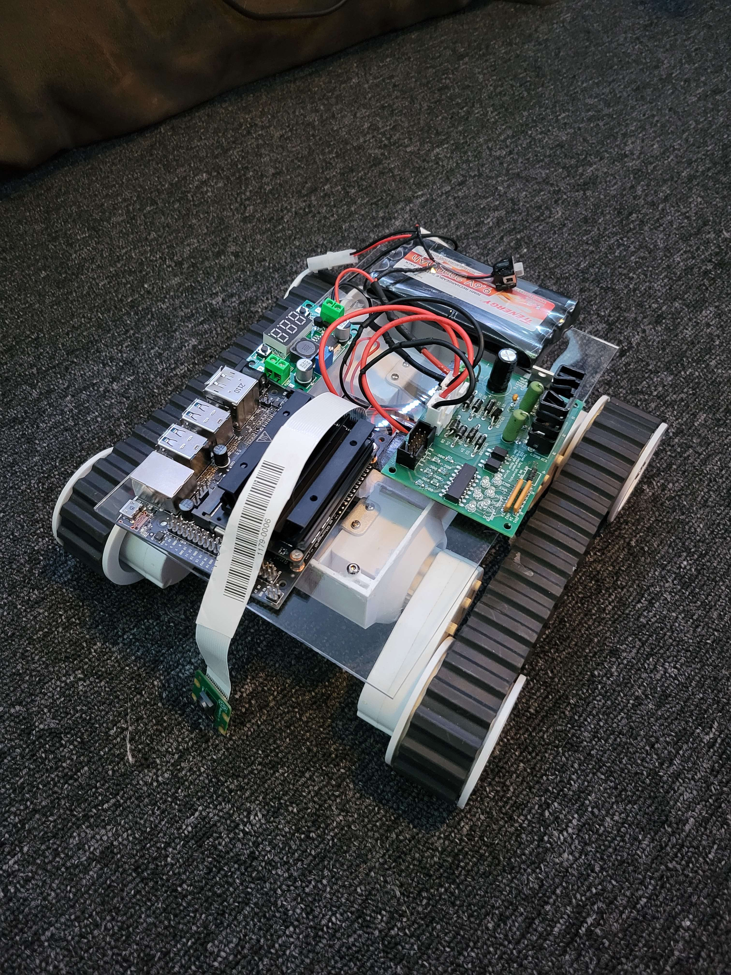
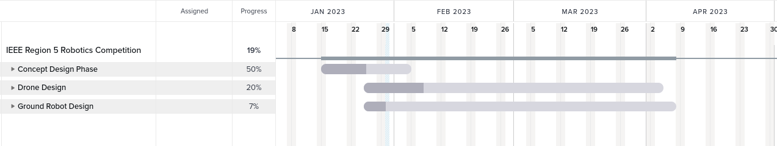
Project Sketch
Project Description, Opportunity, Objectives
Drone and Ground Robot Communicate to Autonomously Navigate Course
Drones Delivering Packages From Trucks, Drones Monitoring Conditions for Ships
Drone and Groundbot Read QR Codes On Boxes to Determine which Box to go to
Project Ascension Quad Chart
Technical Approach
Summary Budget and Gantt Chart
Tello Drone Training Drone
Homemade Drone: STM32F722RET6 FC, SX1280 Transmitter/Receiver, Custom-Made Body, RunCam Phoenix Camera, PX4 Software
Groundbot: PL1 Rover Body, Homemade H-bridge/Buck Converter, Jetson Nano, Python Ground Control Software
Estimate: 31,688.83
Running: 2,936.77

Slide 2

Project Ascension
Not
pew pew
Steve Gillet – Software Engineer
Rishikesh – Hardware Engineer
Isaac Mondragon – integration engineer

Slide 3
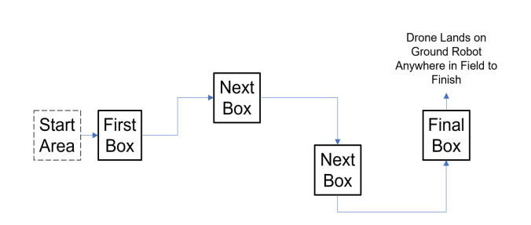
Project Description
Drone Starts On Groundbot
Drone Takes Off and Hovers First Box and Groundbot Enters First Box
Reads QR Code Inside Box and Drone Goes to Find That Box
Groundbot Enters That Box and Process Repeats

Slide 4

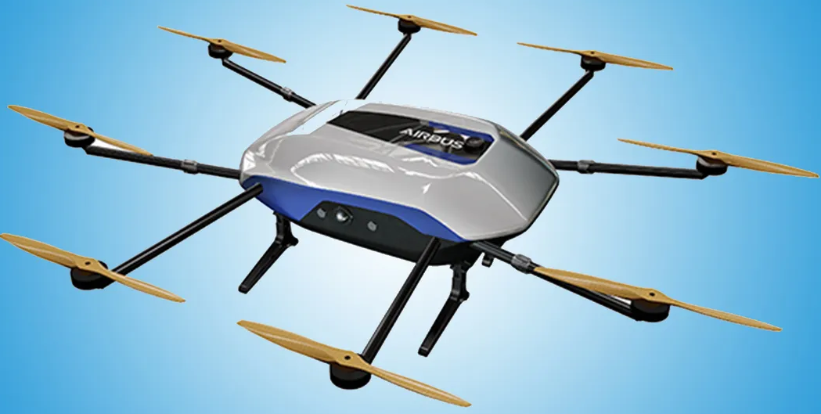
Software FlowChart
Don’t Do It!
Start Search Pattern
Groundbot Stores Next QR Code
Drone Finds Next QR Code
Drone Stops and Groundbot Goes to Drone
Groundbot Sees Box and Goes Inside

Slide 5

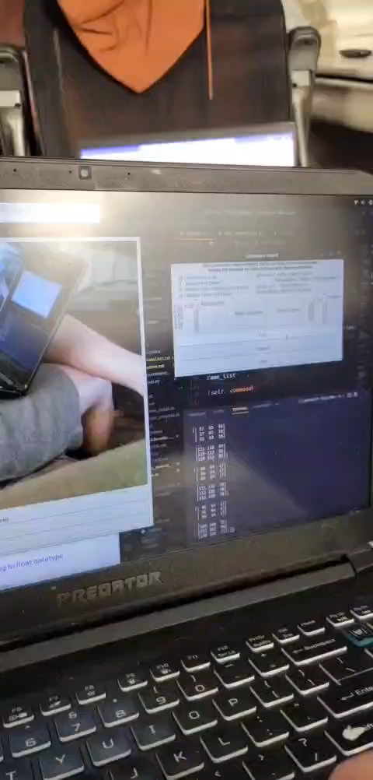
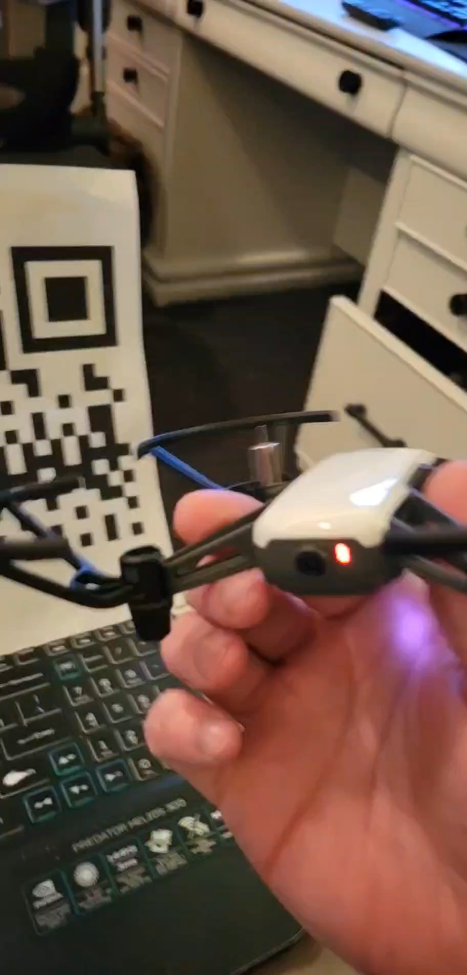
QRCode Detection Drone-Side
Drone Video on Ground Control Software
Getting Video From Drone on Ground Control Software
Python Wifi Sockets and OpenCV and H264 Decoder
Drone software to detect QR Codes using OpenCV
Concern with Accuracy and Looking Down

Slide 6
GRound Robot
Components
9.6 Volt Battery (2000 maH)
H-Bridge
Buck Converter (5V-3A)
Jetson Nano
-Linux, supports OpenCV , 40 pin headers, parallel processing
Raspberry Pi Camera (Photo Resolution: 3280 x 2464 pixel : Video Resolution: 1080p30)
Future Components?
Servo Motor
Distance Sensors
Transceiver

Slide 7
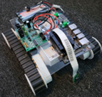
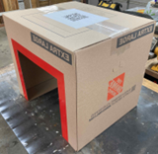
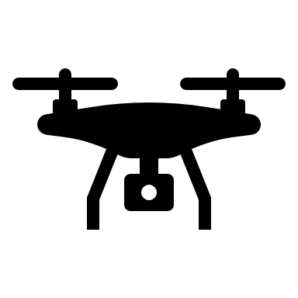
Ground Robot control
Using OpenCV
Leads the Ground Robot to Box underneath
Object Detection
Object Tracking
Finds Entry and Exit Point Using IR Sensors
The Robot Transmits
“DONE” Command to the Drone.
The Drone Lands Back on the Ground Robot
Process Repeats Till The Last Box

Slide 8
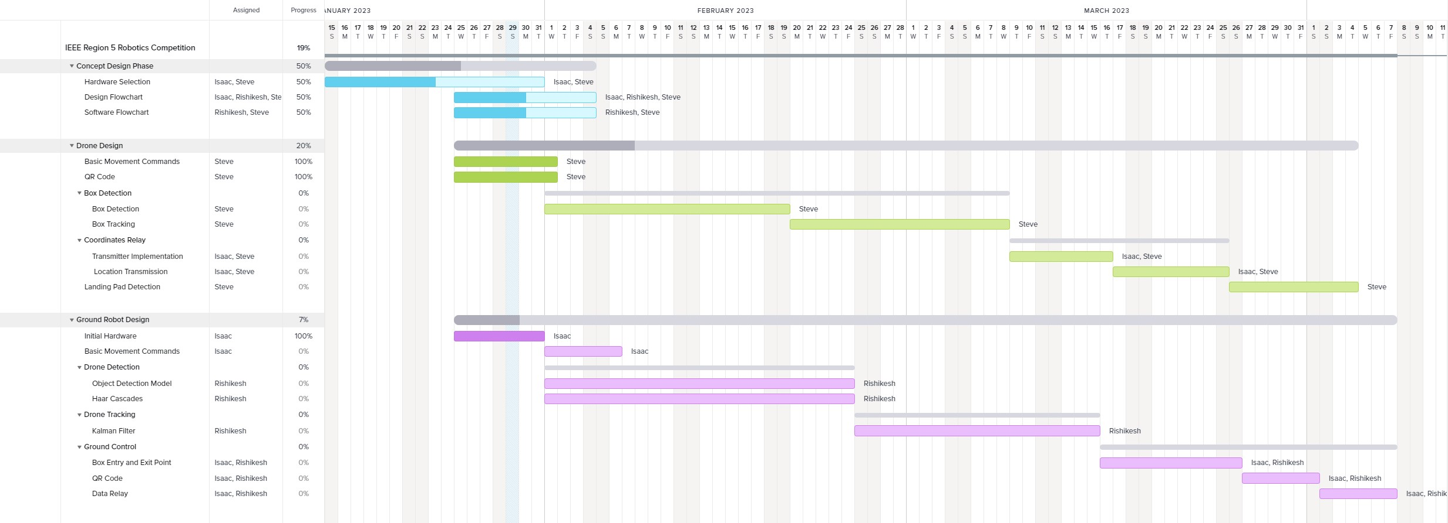
Gantt Chart

Slide 9
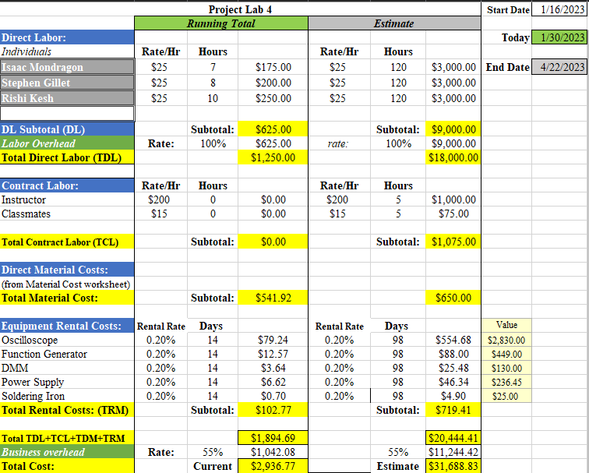
Budget CHart

Slide 10
Credits
Tello Picture: https://www.igeekphone.com/30-off-dji-tello-mini-drone-hd-5mp-wifi-fpv-for-just-99-99/
Octodrone picture: dronedj.com

Slide 11
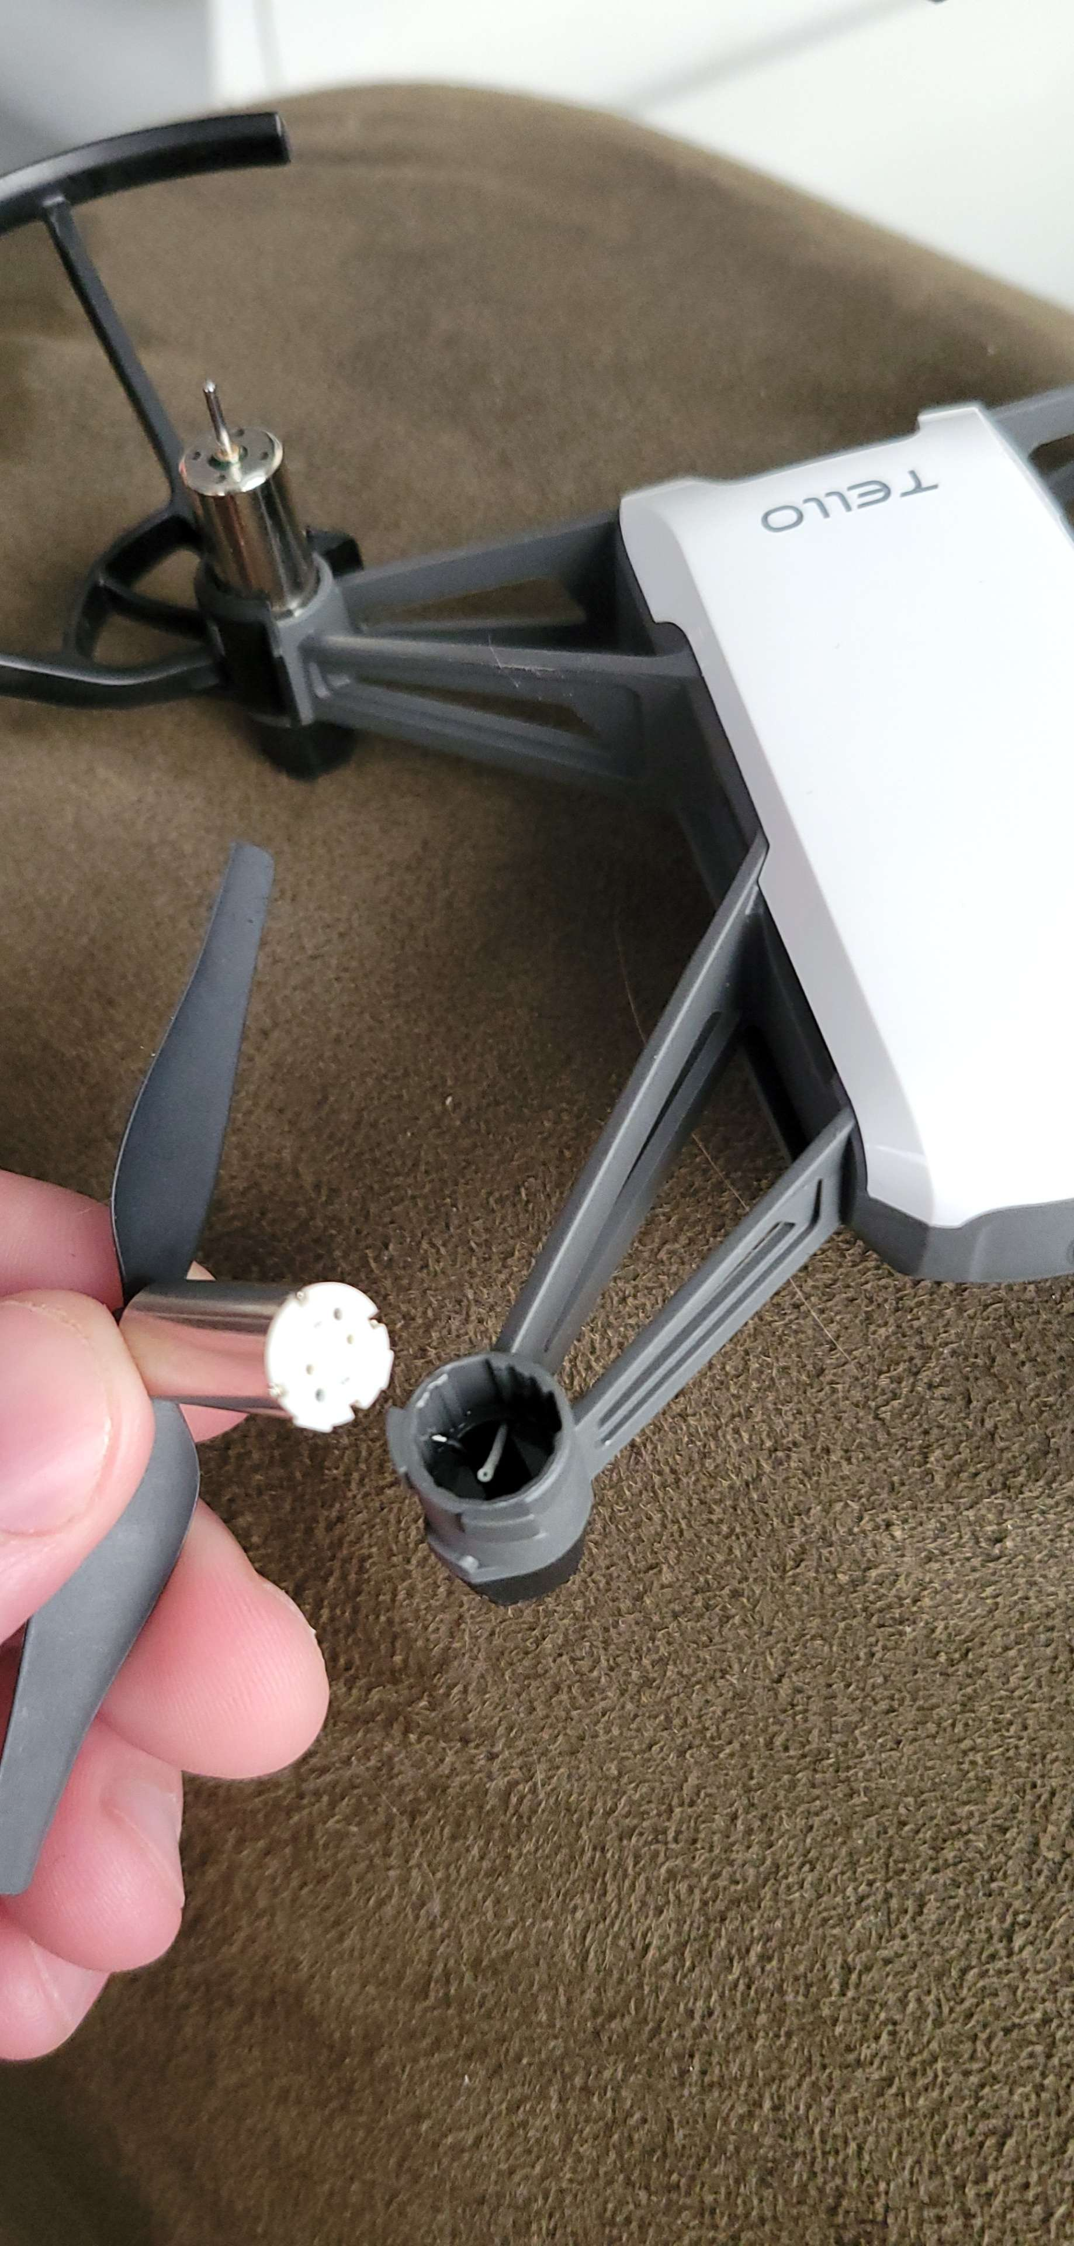

Thank you?
Flora@contoso.com
http://www.contoso.com/

